Slide 1
PYTHON
Lecture - 06
Python Control Statements
conditional statements
loops

Slide 2
Recap
Print formats
User Input
Control Statements (If-elif-else)
Homework (Problem Based on if-else statements)
Class work
Write a Python program that takes the age of a person as input and classifies them into one of the following age groups:
Child: 0-12 years
Teen: 13-19 years
Adult: 20-64 years
Senior: 65 years and above

Slide 3
Contents
Problem Solving with Quiz
Loop statements

Slide 4
Write a python code that prints your name 10 times.
Sample Output:
Donald Trump
Donald Trump
Donald Trump
Donald Trump
Donald Trump
Donald Trump
Donald Trump
Donald Trump
Donald Trump
Donald Trump

Slide 5
Loops in Python
Python primarily offers two types of loops:
While: while loop in Python repeatedly executes a block of code as long as a specified condition remains True.
For: for loop in Python is used to iterate over a sequence (such as a list, tuple, string, or range) and execute a block of code for each element in the sequence

Slide 6
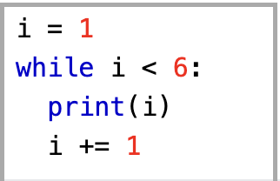
While in Python
syntax
initialization
while expression:
statement(s)
inc/dec

Slide 7
While in Python (Example)
Print your name 10 times:
i = 1 while i <=10: print(“Donald Trump”) i += 1
Now try to print all name in a single line with separated by comma [hints: use end=“”]
Print number 1 to 20

Slide 8
for in Python (Example)
A for loop is used for iterating over a sequence (that is either a list, a tuple, a dictionary, a set, or a string).
This is less like the for keyword in other programming languages, and works more like an iterator method as found in other object-orientated programming languages.
With the for loop we can execute a set of statements, once for each item in a list, tuple, set etc.
fruits = ["apple", "banana", "cherry"] for x in fruits: print(x)

Slide 9
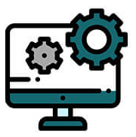
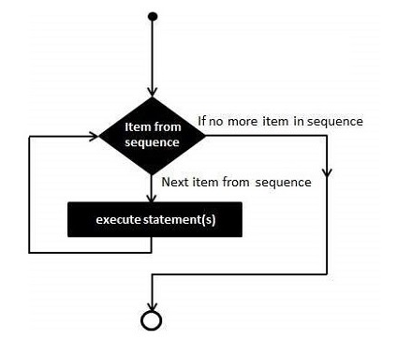
Python For Loop (Syntax)
for iterating_var in sequence:
statements(s)

Slide 10
Python For Loop (Example - 1)
Iterate over a List and print it’s elements.
cities = ['Barisal', 'Dhaka', 'Khulna', 'Sylhet']
for city in cities:
print(city)
OUTPUT
Barisal
Dhaka
Khulna
Sylhet

Slide 11
Python For Loop (Example - 2)
Given last 5 days temperature in a list. Find its average.
temp = [35.8, 39.6, 38.2, 40.8, 41.2]
sum = 0.0
for x in temp:
sum+=x
avg = sum/len(temp)
print(avg)
OUTPUT
39.12

Slide 12
Python For Loop (Example - 3)
Print all chars of a given string
s = "university"
for i in s:
print(i)
OUTPUT
u
n
i
v
e
r
s
i
t
y

Slide 13
Python For Loop with range() Function
range(start, stop, step) → returns a List of int datatype
Start − Starting value of the range. Optional. Default is 0
Stop − The range goes upto stop-1
Step − Integers in the range increment by the step value. Optional, default is 1.
range(2,10,2) → 2, 4, 6,8
range(6) → 0, 1, 2, 3, 4, 5

Slide 14
Python For Loop (Example-01)-Using range
Iterate over a List and print it’s elements.
cities = ['Barisal', 'Dhaka', 'Khulna', 'Sylhet']
for i in range(len(cities)):
print(cities[i])
OUTPUT
Barisal
Dhaka
Khulna
Sylhet

Slide 15
Python For Loop (Example - 2)
Given last 5 days temperature in a list. Find its average.
temp = [35.8, 39.6, 38.2, 40.8, 41.2]
sum = 0.0
for i in range(len(temp)):
sum+=temp[i]
avg = sum/len(temp)
print(avg)
OUTPUT
39.12

Slide 16
Python For Loop (Example - 3)
Print all chars of a given string
s = "university"
for i in range(len(s)):
print(s[i])
OUTPUT
u
n
i
v
e
r
s
i
t
y

Slide 17
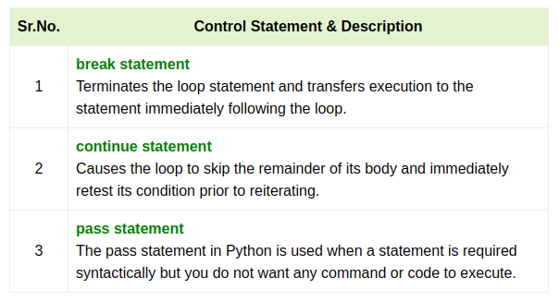
Python Loop Control Statement

Slide 18
Python Loop Control Statement (break)
Find if the given list has an even value or not.
List = [3, 5, 6, 7, 10]
even = 0
for x in List:
if x%2==0:
even = 1
break
if even:
print("Found")
else:
print("Not Found")
OUTPUT
Found

Slide 19
Python Loop Control Statement (continue)
Given a list. Print all odd numbers from the list.
List = [3, 5, 6, 7, 10]
for x in List:
if x%2==0:
continue
print(x)
OUTPUT
3
5
7

Slide 20
Python Loop Control Statement (pass)
It is a null operation; nothing happens when it executes. Python pass statement is also useful in places where your code will eventually go, but has not been written yet.
s = "university"
for i in range(len(s)):
pass
OUTPUT
#The code print nothing.

Slide 21
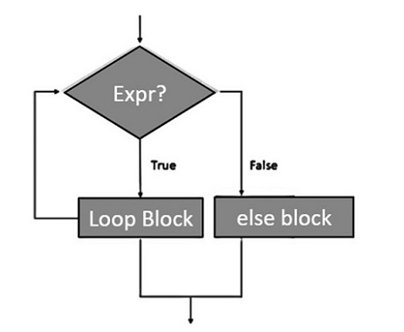
Python for-else Loop (Syntax)
for variable_name in iterable:
#stmts in the loop
.
.
else:
#stmts in else clause
.
.

Slide 22
Python for-else Loop (Example)
Find if the given list has an even value or not.
List = [3, 5, 11, 7, 9]
for x in List:
if x%2==0:
print("Found")
break
else:
print("Not Found")
OUTPUT
Not Found

Slide 23
Python for-else Loop (Example)
Find if the given list has an even value or not.
List = [3, 5, 10, 7, 9]
for x in List:
if x%2==0:
print("Found")
break
else:
print("Not Found")
OUTPUT
Found

Slide 24
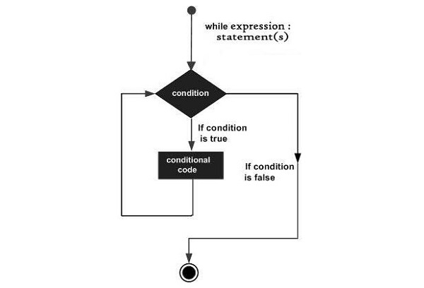
Python While Loop (Syntax)
initialization
while expression:
statement(s)
inc/dec

Slide 25
Python While Loop (Example - 1)
Iterate over a List and print it’s elements.
cities = ['Barisal', 'Dhaka', 'Khulna', 'Sylhet']
i = 0
while(i<len(cities)):
print(cities[i])
i+=1
OUTPUT
Barisal
Dhaka
Khulna
Sylhet

Slide 26
Python While Loop (Example - 2)
Given last 5 days temperature in a list. Find its average.
temp = [35.8, 39.6, 38.2, 40.8, 41.2]
sum = 0.0
i = 0
while i<len(temp):
sum+=temp[i]
i+=1
avg = sum/len(temp)
print(avg)
OUTPUT
39.12

Slide 27
Python While Loop (Example - 3)
Print all chars of a given string
s = "university"
i = 0
while i<len(s):
print(s[i])
i+=1
OUTPUT
u
n
i
v
e
r
s
i
t
y

Slide 28
Python Nested Loop (Syntax)
for iterating_var in sequence:
for iterating_var in sequence:
statements(s)
statements(s)

Slide 29
Python Nested Loop (Example - 1)
Print all prime numbers upto 100
num = 2
while(num <= 100):
j = 2
while(j <= (num/j)):
if not(num%j):
break
j = j + 1
if(j > num/j):
print(num,"is prime")
num = num + 1
OUTPUT
2 is prime
3 is prime
5 is prime
…
…
89 is prime
97 is prime

Slide 30
Exercise – Bonus_01
Find the sum of numbers from 1 to 5.
Find the sum of numbers from 1 to 10.
Given N. Find the sum of numbers from 1 to N.
Print all numbers for 10 to 1.

Slide 31
Exercise-Homework
Write a Python program that prints the multiplication table of a given number n.
Write a Python program that calculates the factorial of a given number n. The factorial of a number is the product of all positive integers up to that number.
Write a Python program that prints all even numbers from 1 to a given number n.
Write a Python program that prints the numbers from 1 to 50. For multiples of 3, print "Fizz" instead of the number, and for multiples of 5, print "Buzz". For numbers which are multiples of both 3 and 5, print "FizzBuzz".
Write a Python program that takes a list of numbers and finds the largest number in the list using a loop.

Slide 32
Exam Announcement
Class Test (10%):
-Date: Next Friday (06 sept)
-Quiz: mcq and short question
-lab Test: you have to write program for a given problem.
-Syllabus: Till today (03 sept)
Midterm (20%):
-Date: Friday (13 sept)
-Quiz: mcq and short question
-lab Test: you have to write program for a given problem.
-Syllabus: Upto previous class of exam day.

Slide 33
Resources
https://www.tutorialspoint.com/python/index.htm
https://www.w3resource.com/python/python-tutorial.php
https://www.w3resource.com/python-exercises/string/
https://www.w3schools.com/python/
https://www.geeksforgeeks.org/python-programming-language/
https://youtu.be/t2_Q2BRzeEE?si=OO6J_YNCZykedqsT
https://realpython.com/
Head First Python, 3rd Edition by Paul Barry
Automate the Boring Stuff with Python By Al Sweigart.

Slide 34
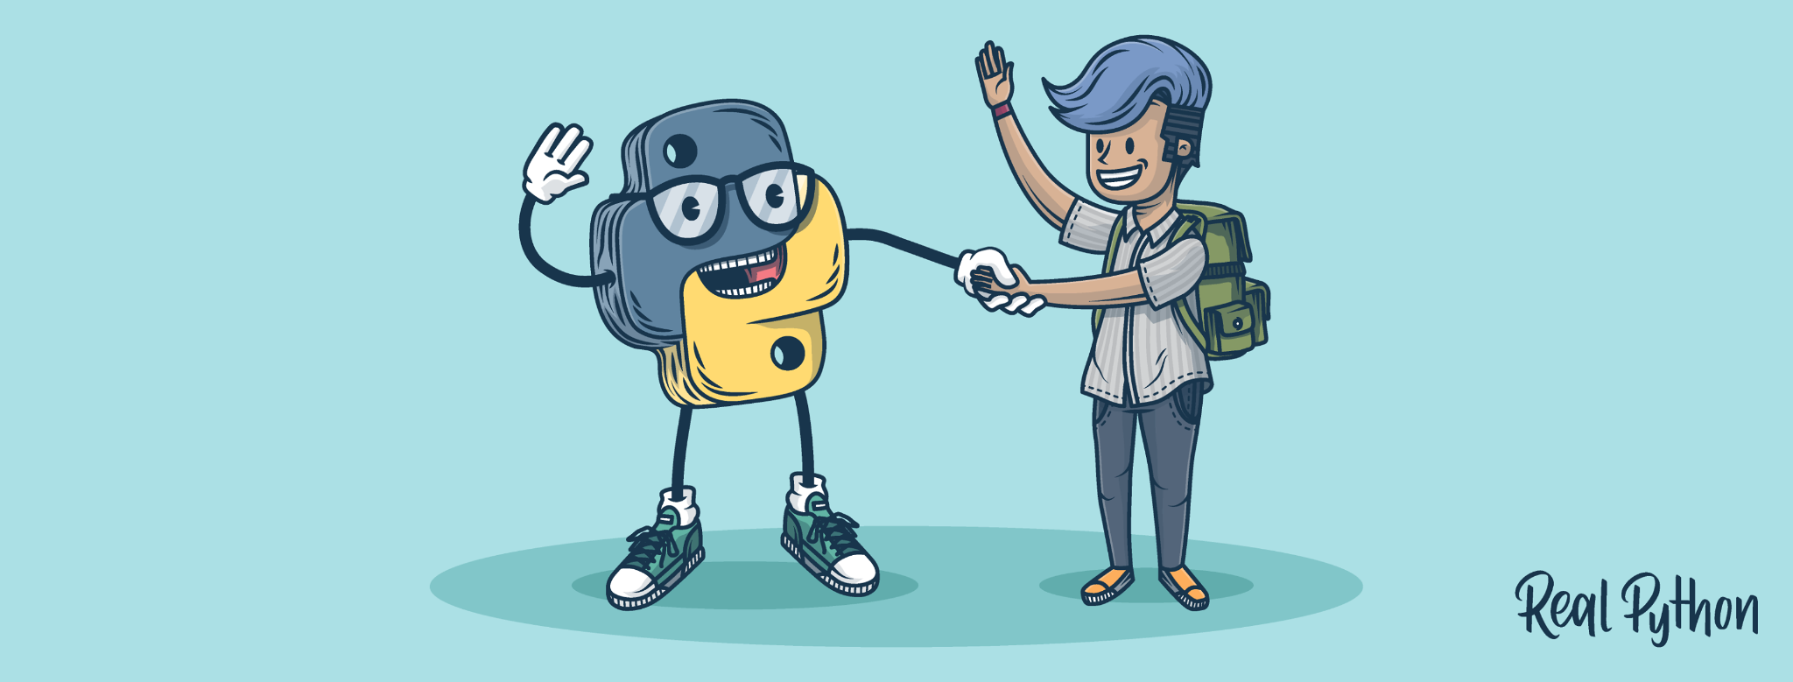
Thank You

